Slide 1

TWO-FACTOR
AUTHENTICATION PROJECT
A Q U I C K I N T R O D U C T I O N T O 2 FA A N D I T S U S E AT
G E O R G I A T E C H

Slide 2
AGENDA
What is Two-Factor Authentication (2FA)? Why Two-Factor?
Two-Factor Project Goals Cas + Duo Project Scope Project Progress
Project Ahead
Project Considerations Demo
Admin.Net10/28/2015

Slide 3


TWO-FACTOR IS….

Slide 4
Computer access control requiring two or more types of authentication factors
WHAT IS TWO-FACTOR AUTHENTICATION ( 2FA)?
Knowledge Factor
Something you know (Password/hints)
Typical single factor method
Possession Factor
Something you own/possess
– Tokens
Inherence Factors
Something you are (Fingerprint(biometric)
Location Factors
Time Factors

Slide 5


WHY TWO-FACTOR?
Because hackers are gonna
hack!
Passwords are not secure
Successful phishing attacks escalate need for more secure system access
Administrative Access
Data Access Risk

Slide 6
WHY TWO-FACTOR AUTHENTICATION?
Currently, many critical applications are secured with a single authentication method using CAS
Early phases of Two-factor Authentication with Duo for specific applications have been successful in limited release
Institute directive to implement a multi-factor integrated solution on a more comprehensive scale

Slide 7

TWO-FACTOR PROJECT GOALS

Slide 8
TWO-FACTOR PROJECT GOAL
Maintain the integrity of Institute data and computing resources
Build a framework for OIT and campus unit resources
Provide two-factor authentication to faculty, staff, and students
Leverage familiar access method with added multifactor capability to ease change impact

Slide 9
Slow and Steady!
CAS + TWO-FACTOR PROJECT SCOPE
First: Experienced Duo users
Leverage existing tools for support used today
Cas
Passport
Technology Support Center (TSC)
Duo administrators
Identify opportunities for improved deployment in next phase
President’s Office and Cabinet
Development Office
Campus Deployment for Administrative Departments in Phases

Slide 10
PROJECT PROGRESS
Deployment has been multi-phased to date:
Phase 0: Campus Multi-Factor Infrastructure and VPN
Phase 1: IT Systems
Users Impacted: IT Personnel
Phase 2: Banner Grades
Users Impacted: Grade submitters (Limited faculty)
Phase 3: Two-factor VPN for Campus Unit Firewalls
Users Impacted: Faculty and Staff
Phase 4: Enforcement of all existing users of two-factor authentication
All of OIT
Primarily IT personnel on campus
Phase 5
Development Office
Presidents Office and Cabinet

Slide 11

Phase 6 – forward
PROJECT AHEAD – NEXT STEPS
Administration and Finance
Academic Departments
Faculty
Students
Retirees?
Current Use:
Approximately over 4000 registered users

Slide 12
In progress
PROJECT PROGRESS CONSIDERATIONS
Change management
Out-reach to off campus users

Slide 13
Self-service enablement methods
NEW FEATURES
Passport
Two-factor menu – add or change a device
Assist Another Person (Web of Trust) (Passport)
CAS (login@gatech.edu) status of app

Slide 14
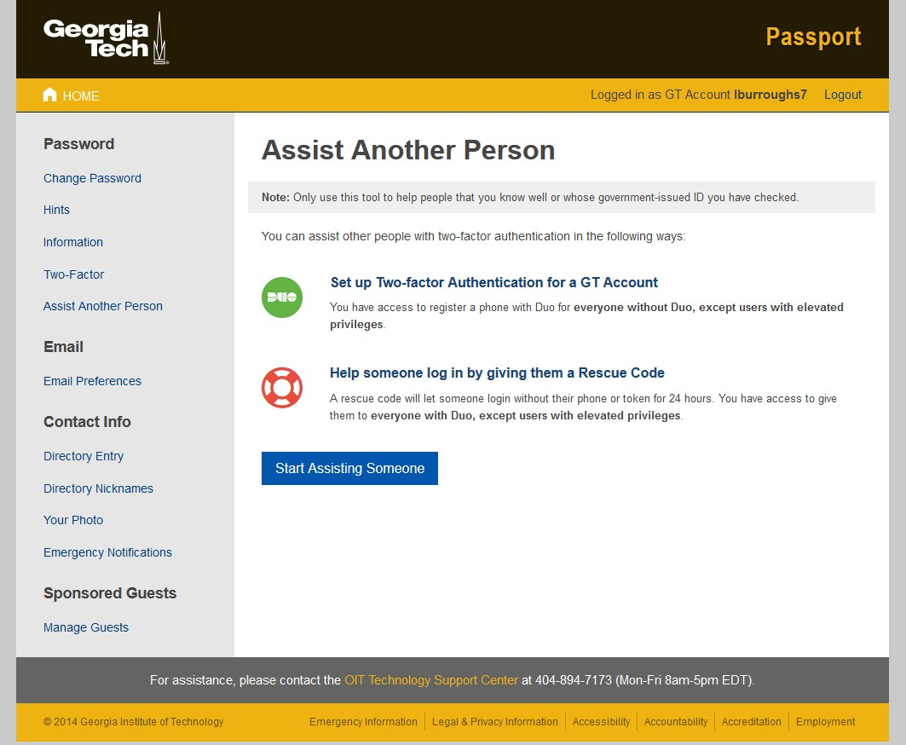
ASSIST ANOTHER PERSON ( WEB OF TRUST)

Slide 15
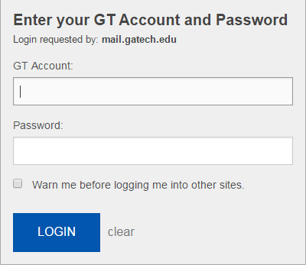
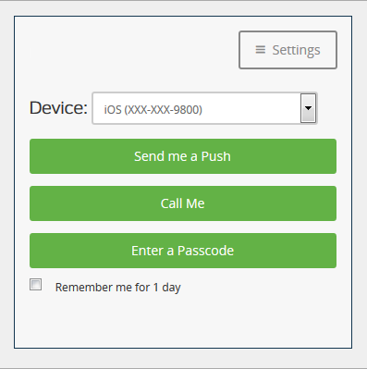


SINGLE SIGN-ON WITH DUO - DEMO

Slide 16
RESOURCES
Website www.twofactor.oit.gatech.edu FAQ’s
https://faq.oit.gatech.edu/security https://faq.oit.gatech.edu/duo-2fa
https://faq.oit.gatech.edu/content/using-2-factor-authentication-vpn-windows https://faq.oit.gatech.edu/content/vpn-2-factor-authentication-osx
Related References
http://www.nbcnews.com/tech/security/universities-become-targets-hackers- n429821
Referenced in News Report: Symantec's Internet Security Threat Report
https://www.symantec.com/content/en/us/enterprise/other_resources/21
347933_GA_RPT-internet-security-threat-report-volume-20-2015.pdf

Slide 17

QUESTIONS

